Slide 1

Team 3
College Crusaders
“Our goal is to enhance student awareness and help guide individuals toward careers in which there is a great demand within the community.”
Members: Taylor Jesse, Dale Peffer, Toshal Ghimire, Joey Pucciarelli, Jim Jenkins, Nolawee Mengist

Slide 2
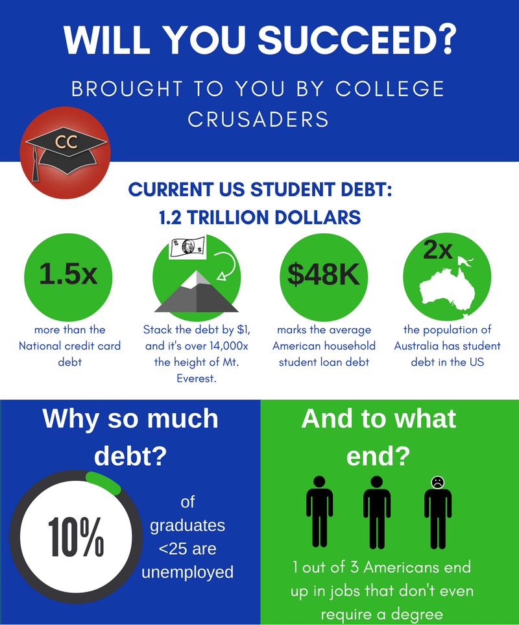
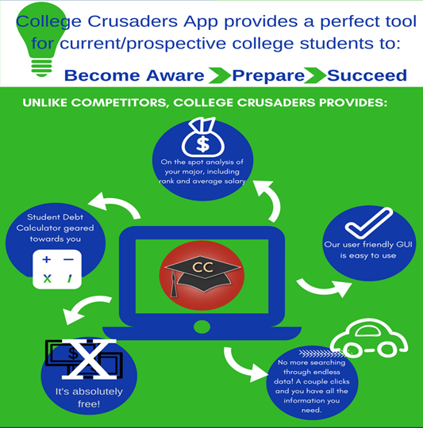

Slide 3
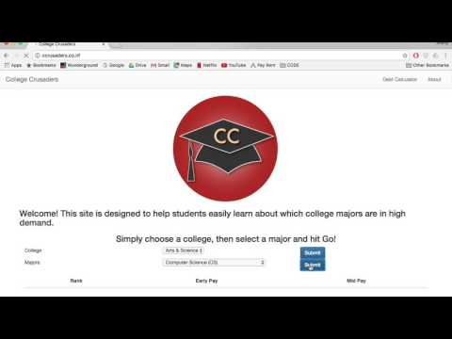
DEMO

Slide 4
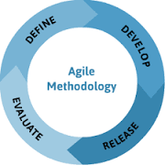
Agile Methodology
2 week sprint cycle
Weekly standup meeting?
What did I complete this week?
What do I plan to complete?
What roadblocks do I have?
Notes:
We used Agile for our Software Development Methodology. We decided Agile fit our product better because we wanted to be able to implement new features at any point in time. We were able to add these features (like our debt calculator) if we had the available time, but they were not essential for our product to fulfil its main purpose.
We chose to do 2 week sprint cycles with weekly standup meetings. Daily scrum meeting were not possible because of our busy schedules, but to make up for this, we used Slack, which Tosh will talk about in a minute. During our weekly standup meeting each member of the team shared with the group 3 things: what he/she completed that week, what he/she plans to complete the next week, and any roadblocks he/she have that are preventing them from completing their work.
By everyone sharing their answers to these 3 questions, the whole group was able to get an idea about where we were in our project. From this, we knew how much or how little work we needed to get done in the following sprint. Now here is Tosh to talk about Slack and our collaboration tools.

Slide 5


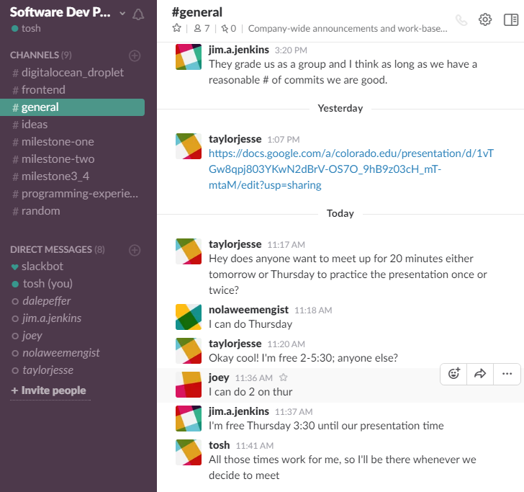
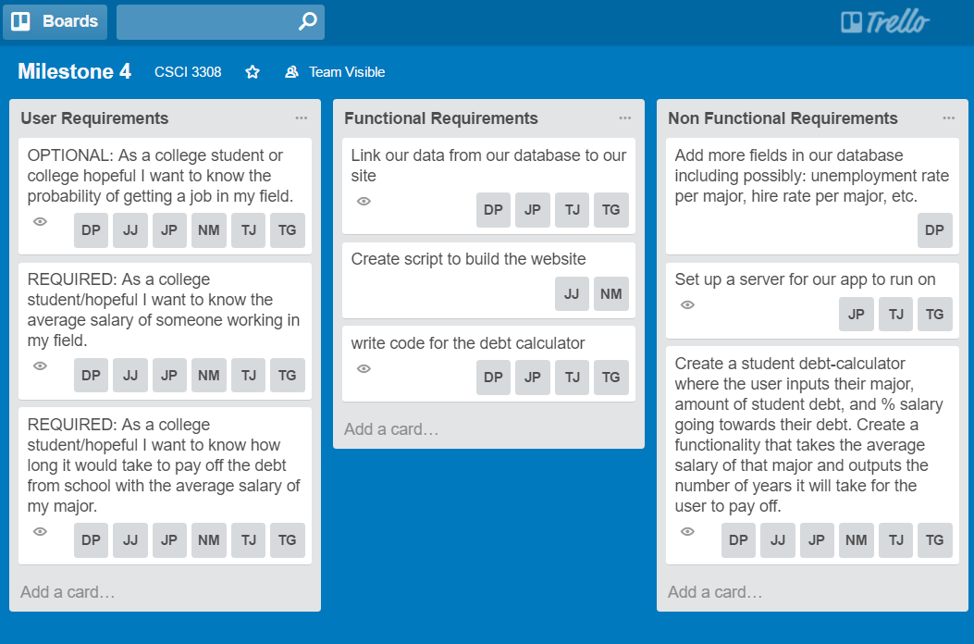

Collaboration Tools
Notes:
We used slack to do majority of our communication, we had many different channels that we created as the semester went on, from an ideas and programing experiences to channels for major milestones and for our separate groups of front end and back. We also used slack to send links and files.
In trello, we set goals and requirements. We used their boards to assign people to certain tasks and used it like a check list for our project.
Another tool we used, was google docs, and presentation. We used docs to write up all our milestones and agile retrospective before committing it to github. We used google presentation to do our slides for final and class presentations.

Slide 6






Coding Process
Front-End
HTML/CSS
Javascript
PHP
Back-End
SQL
VCS
Git/Github
Notes:
We used Agile for our Software Development Methodology. We decided Agile fit our product better because we wanted to be able to implement new features at any point in time. We were able to add these features (like our debt calculator) if we had the available time, but they were not essential for our product to fulfil its main purpose. We chose to do 2 week sprint cycles with weekly standup meetings. Daily scrum meeting were not possible because of our busy schedules, but to make up for this, we used Slack, which Tosh will talk about in a minute. During our weekly standup meeting each member of the team shared with the group 3 things: what he/she completed that week, what he/she plans to complete the next week, and any roadblocks he/she have that are preventing them from completing their work. By everyone sharing their answers to these 3 questions, the whole group was able to get idea about where we were in our project. From this, we knew how much or how little work we needed to get done in the following week. Now here is Tosh to talk about Slack and our collaboration tools.

Slide 7

Team 3 & College Crusaders
Thanks you!
Future Additions:
School specific earnings and debt values
Adjustable percentage of salary paid towards debt
Customizable loan interest rate
“The first step towards success is knowing!”
Find us at: ccrusaders.co.nf

